Slide 1
Programming With C++/R
DST102TC
Huakang Li
Huakang.li@xjtlu.edu.cn
School of AI and Advanced Computing
Notes:
English Title: Uppercase, Calibri size 60, XJTLU Navy
English Subtitle: Uppercase, Calibri size 36, XJTLU Navy

Slide 2
Chapter 3
Selection
Notes:
English Title: Uppercase, Calibri size 60, XJTLU Navy
English Subtitle: Uppercase, Calibri size 36, XJTLU Navy

Slide 3
Motivations
If you assigned a negative value for radius in Listing 2.1, ComputeArea.cpp, the program would print an invalid result. If the radius is negative, you don't want the program to compute the area. How can you deal with this situation?

Slide 4
Objectives
To declare bool variables and write Boolean expressions using relational operators (§3.2).
To implement selection control using one-way if statements (§3.3).
To program using one-way if statements (GuessBirthday) (§3.4).
To implement selection control using two-way if statements (§3.5).
To implement selection control using nested if and multi-way if-else statements (§3.6).
To avoid common errors and pitfalls in if statements (§3.7).
To generate random numbers using the rand function and set a seed using the srand function (§3.9).
To combine conditions using logical operators (&&, ||, and !) (§3.10).
To program using selection statements with combined conditions (LeapYear, Lottery) (§§3.11–3.12).
To implement selection control using switch statements (§3.13).
To write expressions using the conditional operator (§3.14).
To examine the rules governing operator precedence and operator associativity (§3.15).

Slide 5
The bool Type and Operators
Often in a program you need to compare two values, such as whether i is greater than j.
C++ provides six relational operators (also known as comparison operators) in Table 3.1 that can be used to compare two values.

Slide 6
Relational Operators

Slide 7
One-way if Statements
if (radius >= 0)
{
area = radius * radius * PI;
cout << "The area for the circle of " <<
" radius " << radius << " is " << area;
}
if (booleanExpression)
{
statement(s);
}

Slide 8
Note

Slide 9
Examples
Listing 3.1 gives a program that prompts the user to enter an integer. If the number is a multiple of 5, display HiFive. If the number is even, display HiEven.
#include <iostream>
using namespace std;
int main()
{
// Prompt the user to enter an integer
int number;
cout << "Enter an integer: ";
cin >> number;
if (number % 5 == 0)
cout << "HiFive" << endl;
if (number % 2 == 0 )
cout << "HiEven" << endl;
return 0;
}

Slide 10
Caution
Adding a semicolon at the end of an if clause is a common mistake.
This mistake is hard to find, because it is not a compilation error or a runtime error, it is a logic error.
This error often occurs when you use the next-line block style.

Slide 11
The if...else Statement
if (booleanExpression)
{
statement(s)-for-the-true-case;
}
else
{
statement(s)-for-the-false-case;
}

Slide 12
Nested if Statements
if (i > k)
{
if (j > k)
cout << "i and j are greater than k";
}
else
cout << "i is less than or equal to k";

Slide 13
Multiple Alternative if Statements

Slide 14
Trace if-else statement
Suppose score is 70.0
The condition is false
if (score >= 90.0)
cout << “Grade is A";
else if (score >= 80.0)
cout << “Grade is B";
else if (score >= 70.0)
cout << “Grade is C";
else if (score >= 60.0)
cout << “Grade is D";
else
cout << “Grade is F";

Slide 15
Trace if-else statement
Suppose score is 70.0
The condition is false
if (score >= 90.0)
cout << “Grade is A";
else if (score >= 80.0)
cout << “Grade is B";
else if (score >= 70.0)
cout << “Grade is C";
else if (score >= 60.0)
cout << “Grade is D";
else
cout << “Grade is F";

Slide 16
Trace if-else statement
Suppose score is 70.0
The condition is true
if (score >= 90.0)
cout << “Grade is A";
else if (score >= 80.0)
cout << “Grade is B";
else if (score >= 70.0)
cout << “Grade is C";
else if (score >= 60.0)
cout << “Grade is D";
else
cout << “Grade is F";

Slide 17
Trace if-else statement
Suppose score is 70.0
grade is C
if (score >= 90.0)
cout << “Grade is A";
else if (score >= 80.0)
cout << “Grade is B";
else if (score >= 70.0)
cout << “Grade is C";
else if (score >= 60.0)
cout << “Grade is D";
else
cout << “Grade is F";

Slide 18
Trace if-else statement
Suppose score is 70.0
Exit the if statement
if (score >= 90.0)
cout << “Grade is A";
else if (score >= 80.0)
cout << “Grade is B";
else if (score >= 70.0)
cout << “Grade is C";
else if (score >= 60.0)
cout << “Grade is D";
else
cout << “Grade is F";

Slide 19
Note
The else clause matches the most recent if clause in the same block.

Slide 20
Note, cont.
Nothing is printed from the preceding statement. To force the else clause to match the first if clause, you must add a pair of braces:
int i = 1; int j = 2; int k = 3;
if (i > j)
{
if (i > k)
cout << "A";
}
else
cout << "B";
This statement prints B.

Slide 21
TIP

Slide 22
CAUTION

Slide 23
Common Errors in Selection Statements
Common Error 1: Forgetting Necessary Braces

Slide 24
Common Errors in Selection Statements
Common Error 2: Wrong Semicolon at the if Line

Slide 25
Common Errors in Selection Statements
Common Error 3: Mistakenly Using = for ==
if (count = 1)
cout << "count is zero" << endl;
else
cout << "count is not zero" << endl;

Slide 26
Common Errors in Selection Statements
Common Error 4: Redundant Testing of Boolean Values

Slide 27
Problem: Body Mass Index
Body Mass Index (BMI) is a measure of health on weight. It can be calculated by taking your weight in kilograms and dividing by the square of your height in meters. The interpretation of BMI for people 16 years or older is as follows:

Slide 28
#include <iostream>
using namespace std;
int main()
{
// Prompt the user to enter weight in pounds
cout << "Enter weight in pounds: ";
double weight;
cin >> weight;
// Prompt the user to enter height in inches
cout << "Enter height in inches: ";
double height;
cin >> height;
const double KILOGRAMS_PER_POUND = 0.45359237; // Constant
const double METERS_PER_INCH = 0.0254; // Constant
// Compute BMI
double weightInKilograms = weight * KILOGRAMS_PER_POUND;
double heightInMeters = height * METERS_PER_INCH;
double bmi = weightInKilograms /
(heightInMeters * heightInMeters);
// Display result
cout << "BMI is " << bmi << endl;
if (bmi < 18.5)
cout << "Underweight" << endl;
else if (bmi < 25)
cout << "Normal" << endl;
else if (bmi < 30)
cout << "Overweight" << endl;
else
cout << "Obese" << endl;
return 0;
}

Slide 29
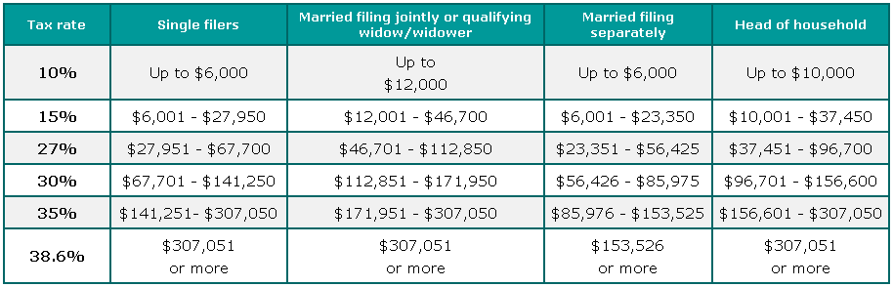
Example: Computing Taxes
The US federal personal income tax is calculated based on the filing status and taxable income. There are four filing statuses: single filers, married filing jointly, married filing separately, and head of household. The tax rates for 2002 are shown in Table 3.6.

Slide 30
Example: Computing Taxes, cont.
if (status == 0)
{
// Compute tax for single filers
}
else if (status == 1)
{
// Compute tax for married file jointly
}
else if (status == 2)
{
// Compute tax for married file separately
}
else if (status == 3)
{
// Compute tax for head of household
}
else
{
// Display wrong status
}

Slide 31
#include <iostream>
using namespace std;
int main()
{
// Prompt the user to enter filing status
cout << "(0-single filer, 1-married jointly, "
<< "or qualifying widow(er)," << endl
<< "2-married separately, 3-head of household)" << endl
<< "Enter the filing status: ";
int status;
cin >> status;
// Prompt the user to enter taxable income
cout << "Enter the taxable income: ";
double income;
cin >> income;
// Compute tax
double tax = 0;
if (status == 0) // Compute tax for single filers
{
if (income <= 8350)
tax = income * 0.10;
else if (income <= 33950)
tax = 8350 * 0.10 + (income - 8350) * 0.15;
else if (income <= 82250)
tax = 8350 * 0.10 + (33950 - 8350) * 0.15 +
(income - 33950) * 0.25;
else if (income <= 171550)
tax = 8350 * 0.10 + (33950 - 8350) * 0.15 +
(82250 - 33950) * 0.25 + (income - 82250) * 0.28;
else if (income <= 372950)
tax = 8350 * 0.10 + (33950 - 8350) * 0.15 +
(82250 - 33950) * 0.25 + (171550 - 82250) * 0.28 +
(income - 171550) * 0.33;
else
tax = 8350 * 0.10 + (33950 - 8350) * 0.15 +
(82250 - 33950) * 0.25 + (171550 - 82250) * 0.28 +
(372950 - 171550) * 0.33 + (income - 372950) * 0.35;
}
else if (status == 1) // Compute tax for married file jointly
{ // Left as exercise}
else if (status == 2) // Compute tax for married separately
{ // Left as exercise}
else if (status == 3) // Compute tax for head of household
{ // Left as exercise}
else
{
cout << "Error: invalid status";
return 0;
}
// Display the result
cout << "Tax is " << static_cast<int>(tax * 100)
/ 100.0 << endl;
return 0;}

Slide 32
Example: A Simple Math Learning Tool
This example creates a program for a first grader to practice subtractions.
The program randomly generates two single-digit integers number1 and number2 with number1 >= number2 and displays a question such as “What is 9 – 2?” to the student, as shown in the sample output.
After the student types the answer, the program displays a message to indicate whether the answer is correct.

Slide 33
#include <iostream>
#include <ctime> // for time function #include <cstdlib> // for rand and srand functions \n using namespace std;
int main()
{ // 1. Generate two random single-digit integers
srand(time(0));
int number1 = rand() % 10;
int number2 = rand() % 10;
// 2. If number1 < number2, swap number1 with number2
if (number1 < number2)
{ int temp = number1;
number1 = number2;
number2 = temp; }
// 3. Prompt the student to answer “what is number1 – number2?”
cout << "What is " << number1 << " - " << number2 << "? ";
int answer;
cin >> answer;
// 4. Grade the answer and display the result
if (number1 - number2 == answer)
cout << "You are correct!";
else
cout << "Your answer is wrong." << endl << number1 << " - "
<< number2 << " should be " << (number1 - number2) << endl;
return 0; }

Slide 34
Logical Operators

Slide 35
Truth Table for Operator !

Slide 36
Truth Table for Operator &&

Slide 37
Truth Table for Operator ||

Slide 38
Examples
Listing 3.3 gives a program that checks whether a number is divisible by 2 and 3, whether a number is divisible by 2 or 3, and whether a number is divisible by 2 or 3 but not both:
#include <iostream>
using namespace std;
int main()
{
int number;
cout << "Enter an integer: ";
cin >> number;
if (number % 2 == 0 && number % 3 == 0)
cout << number << " is divisible by 2 and 3." << endl;
if (number % 2 == 0 || number % 3 == 0)
cout << number << " is divisible by 2 or 3." << endl;
if ((number % 2 == 0 || number % 3 == 0) &&
!(number % 2 == 0 && number % 3 == 0))
cout << number << " divisible by 2 or 3, but not both." << endl;
return(0);
}

Slide 39
Short-Circuit Operator
When evaluating p1 && p2, C++ first evaluates p1 and then evaluates p2 if p1 is true; if p1 is false, it does not evaluate p2.
When evaluating p1 || p2, C++ first evaluates p1 and then evaluates p2 if p1 is false; if p1 is true, it does not evaluate p2.
Therefore, && is referred to as the conditional or short-circuit AND operator, and || is referred to as the conditional or short-circuit OR operator.

Slide 40
Examples
Write a program that lets the user enter a year and checks whether it is a leap year.
A year is a leap year if it is divisible by 4 but not by 100 or if it is divisible by 400. So you can use the following Boolean expression to check whether a year is a leap year:
(year % 4 == 0 && year % 100 != 0) || (year % 400 == 0)

Slide 41
#include <iostream>
using namespace std;
int main()
{
cout << "Enter a year: ";
int year;
cin >> year;
// Check if the year is a leap year
bool isLeapYear =
(year % 4 == 0 && year % 100 != 0) || (year % 400 == 0);
// Display the result in a message dialog box
if (isLeapYear)
cout << year << " is a leap year" << endl;
else
cout << year << " is a not leap year" << endl;
return 0;
}

Slide 42
Problem: Lottery
Randomly generates a lottery of a two-digit number, prompts the user to enter a two-digit number, and determines whether the user wins according to the following rule:
If the user input matches the lottery in exact order, the award is $10,000.
If the user input matches the lottery, the award is $3,000.
If one digit in the user input matches a digit in the lottery, the award is $1,000.

Slide 43
// Get digits from guess
int guessDigit1 = guess / 10;
int guessDigit2 = guess % 10;
cout << "The lottery number is " << lottery << endl;
// Check the guess
if (guess == lottery)
cout << "Exact match: you win $10,000" << endl;
else if (guessDigit2 == lotteryDigit1
&& guessDigit1 == lotteryDigit2)
cout << "Match all digits: you win $3,000" << endl;
else if (guessDigit1 == lotteryDigit1
|| guessDigit1 == lotteryDigit2
|| guessDigit2 == lotteryDigit1
|| guessDigit2 == lotteryDigit2)
cout << "Match one digit: you win $1,000" << endl;
else
cout << "Sorry, no match" << endl;
return 0;
}
#include <iostream>
#include <ctime> // for time function
#include <cstdlib> // for rand and srand functions
using namespace std;
int main()
{
// Generate a lottery
srand(time(0));
int lottery = rand() % 100;
// Prompt the user to enter a guess
cout << "Enter your lottery pick (two digits): ";
int guess;
cin >> guess;
// Get digits from lottery
int lotteryDigit1 = lottery / 10;
int lotteryDigit2 = lottery % 10;

Slide 44
switch Statements
switch (status)
{
case 0: compute taxes for single filers;
break;
case 1: compute taxes for married file jointly;
break;
case 2: compute taxes for married file separately;
break;
case 3: compute taxes for head of household;
break;
default: cout << "Errors: invalid status“ << endl;
}

Slide 45
switch Statement Flow Chart

Slide 46
switch Statement Rules
The switch-expression must yield a value of char, byte, short, or int type and must always be enclosed in parentheses.
switch (switch-expression) {
case value1: statement(s)1;
break;
case value2: statement(s)2;
break;
…
case valueN: statement(s)N;
break;
default: statement(s)-for-default;
}
The value1, ..., and valueN must have the same data type as the value of the switch-expression. The resulting statements in the case statement are executed when the value in the case statement matches the value of the switch-expression. Note that value1, ..., and valueN are constant expressions, meaning that they cannot contain variables in the expression, such as 1 + x.

Slide 47
switch Statement Rules
The keyword break is optional, but it should be used at the end of each case in order to terminate the remainder of the switch statement. If the break statement is not present, the next case statement will be executed.
switch (switch-expression) {
case value1: statement(s)1;
break;
case value2: statement(s)2;
break;
…
case valueN: statement(s)N;
break;
default: statement(s)-for-default;
}
The default case, which is optional, can be used to perform actions when none of the specified cases matches the switch-expression.
When the value in a case statement matches the value of the switch-expression, the statements starting from this case are executed until either a break statement or the end of the switch statement is reached.

Slide 48
Trace switch statement
Suppose day is 3:
switch (day)
{
case 1: // Fall to through to the next case
case 2: // Fall to through to the next case
case 3: // Fall to through to the next case
case 4: // Fall to through to the next case
case 5: cout << "Weekday"; break;
case 0: // Fall to through to the next case
case 6: cout << "Weekend";
}

Slide 49
Trace switch statement
Suppose day is 3:
switch (day)
{
case 1: // Fall to through to the next case
case 2: // Fall to through to the next case
case 3: // Fall to through to the next case
case 4: // Fall to through to the next case
case 5: cout << "Weekday"; break;
case 0: // Fall to through to the next case
case 6: cout << "Weekend";
}

Slide 50
Trace switch statement
Suppose day is 3:
switch (day)
{
case 1: // Fall to through to the next case
case 2: // Fall to through to the next case
case 3: // Fall to through to the next case
case 4: // Fall to through to the next case
case 5: cout << "Weekday"; break;
case 0: // Fall to through to the next case
case 6: cout << "Weekend";
}

Slide 51
Trace switch statement
Suppose day is 3:
switch (day)
{
case 1: // Fall to through to the next case
case 2: // Fall to through to the next case
case 3: // Fall to through to the next case
case 4: // Fall to through to the next case
case 5: cout << "Weekday"; break;
case 0: // Fall to through to the next case
case 6: cout << "Weekend";
}

Slide 52
Trace switch statement
Suppose day is 3:
switch (day)
{
case 1: // Fall to through to the next case
case 2: // Fall to through to the next case
case 3: // Fall to through to the next case
case 4: // Fall to through to the next case
case 5: cout << "Weekday"; break;
case 0: // Fall to through to the next case
case 6: cout << "Weekend";
}

Slide 53
Problem: Chinese Zodiac
Write a program that prompts the user to enter a year and displays the animal for the year.

Slide 54
#include <iostream>
using namespace std;
int main()
{
cout << "Enter a year: ";
int year;
cin >> year;
switch (year % 12)
{
case 0: cout << "monkey" << endl; break;
case 1: cout << "rooster" << endl; break;
case 2: cout << "dog" << endl; break;
case 3: cout << "pig" << endl; break;
case 4: cout << "rat" << endl; break;
case 5: cout << "ox" << endl; break;
case 6: cout << "tiger" << endl; break;
case 7: cout << "rabbit" << endl; break;
case 8: cout << "dragon" << endl; break;
case 9: cout << "snake" << endl; break;
case 10: cout << "horse" << endl; break;
case 11: cout << "sheep" << endl; break;
}
return 0;
}

Slide 55
Conditional Operator
if (x > 0)
y = 1
else
y = -1;
is equivalent to
y = (x > 0) ? 1 : -1;
(booleanExpression) ? expression1 : expression2
Ternary operator
Binary operator
Unary operator

Slide 56
Conditional Operator
cout << ((num % 2 == 0) ? "num is even" : "num is odd");

Slide 57
Conditional Operator, cont.
(booleanExp) ? exp1 : exp2

Slide 58
Operator Precedence
How to evaluate 3 + 4 * 4 > 5 * (4 + 3) – 1?

Slide 59
Operator Precedence
var++, var--
+, - (Unary plus and minus), ++var,--var
(type) Casting
! (Not)
*, /, % (Multiplication, division, and remainder)
+, - (Binary addition and subtraction)
<, <=, >, >= (Comparison)
==, !=; (Equality)
&& (Conditional AND) Short-circuit AND
|| (Conditional OR) Short-circuit OR
=, +=, -=, *=, /=, %= (Assignment operator)

Slide 60
Enumerated Types
enum Day {MONDAY, TUESDAY, WEDNESDAY, THURSDAY, FRIDAY};
Once a type is defined, you can declare a variable of that type:
Day day;
The variable day can hold one of the values defined in the enumerated type. For example, the following statement assigns enumerated value MONDAY to variable day:
day = MONDAY;

Slide 61
Enumerated Types
As with any other type, you can declare and initialize a variable in one statement:
Day day = MONDAY;
Furthermore, C++ allows you to declare an enumerated type and variable in one statement. For example,
enum Day {MONDAY, TUESDAY, WEDNESDAY, THURSDAY, FRIDAY} day = MONDAY;

Slide 62
#include <iostream>
using namespace std;
int main()
{
enum Day {MONDAY = 1, TUESDAY, WEDNESDAY, THURSDAY, FRIDAY} day;
cout << "Enter a day (1 for Monday, 2 for Tuesday, etc): ";
int dayNumber;
cin >> dayNumber;
switch (dayNumber) {
case MONDAY:
cout << "Play soccer" << endl;
break;
case TUESDAY:
cout << "Piano lesson" << endl;
break;
case WEDNESDAY:
cout << "Math team" << endl;
break;
default:
cout << "Go home" << endl;
}
return 0;
}

Slide 63
summarization
input from the keyboard
numeric data types
write integer literals, floating-point literals, and literals in scientific notation
write and evaluate expressions
software development process

Slide 64

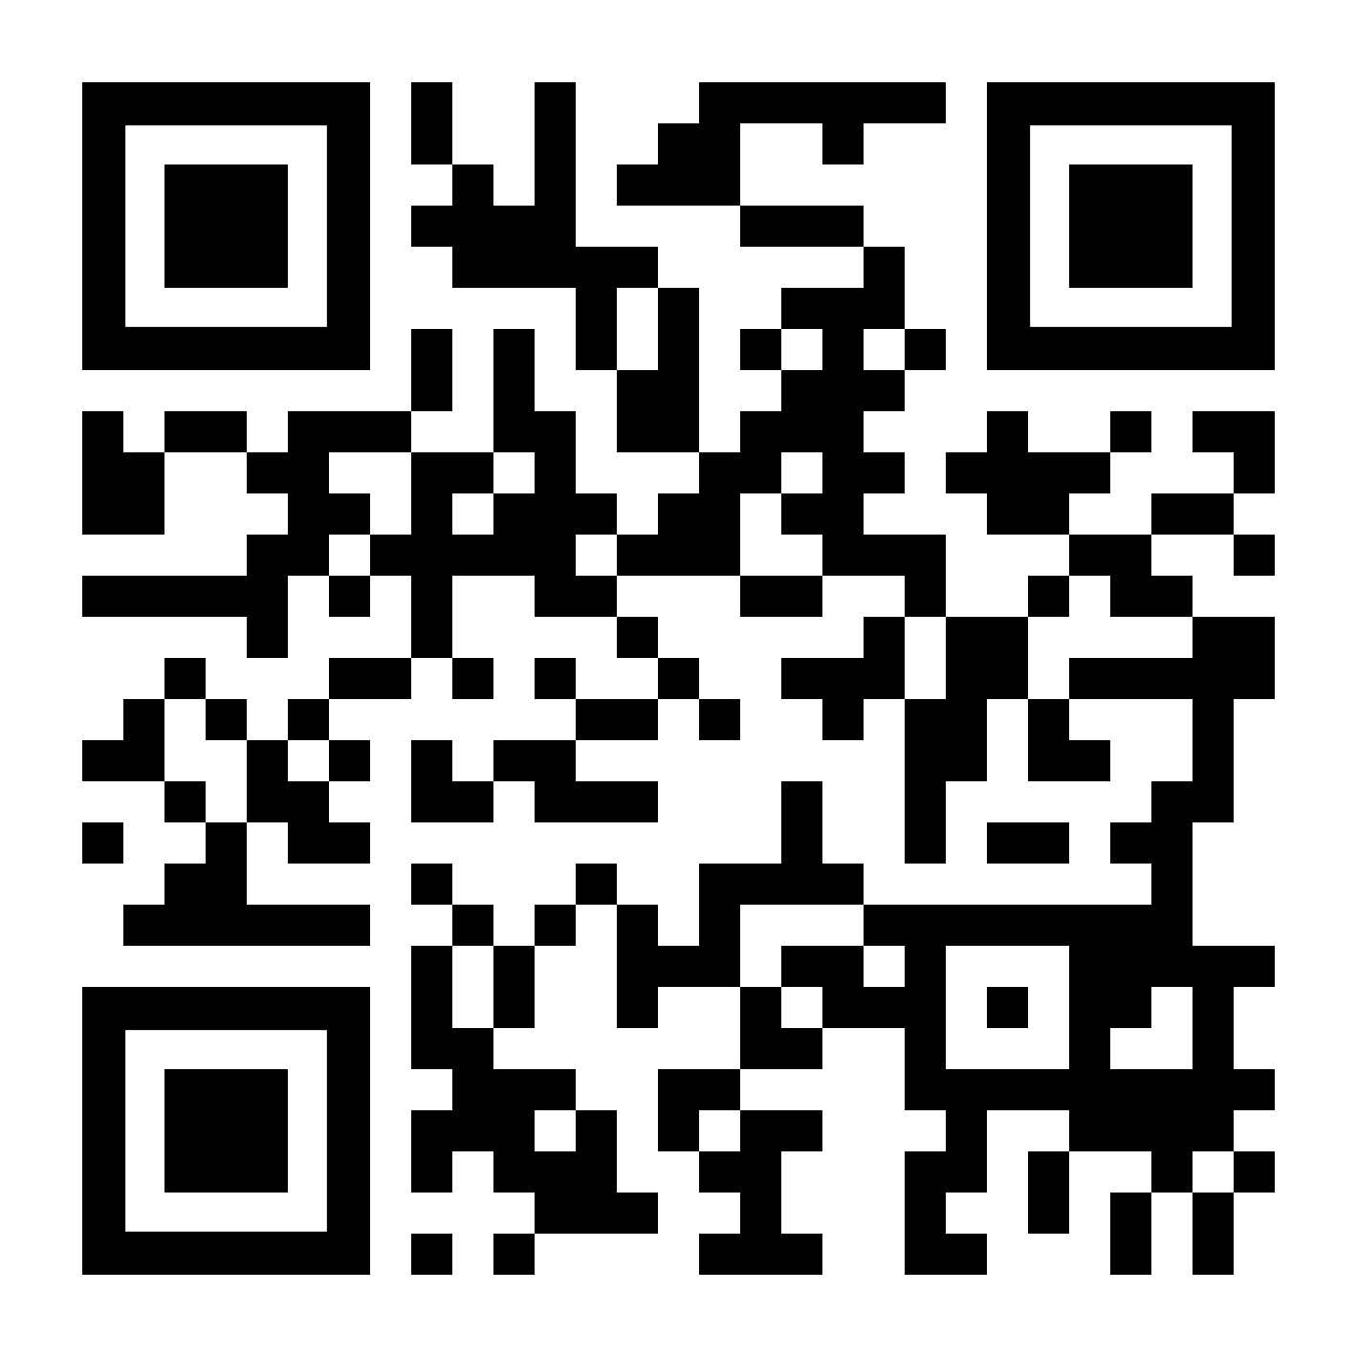

THANK YOU
Visit us
FOLLOW us
www.xjtlu.edu.cn
Notes:
Title: Uppercase, Calibri size 60, XJTLU Navy

